Slide 1
Dynamic Replication of Options: Economic Intuition and Market Stability Implications
Jorge A. Chan-Lau
Institute for Capacity and Development
International Monetary Fund

Slide 2
Dynamic replication of options
Rebalancing = buying and selling securities
Buying and selling could destabilize markets
Replicate option with portfolio of simple securities
Rebalance portfolio constantly to mimic option non-linear payoffs

Slide 3
Economic Intuition
Example: European Call Option, payoff at maturity
C(S) = max(S-K,0)
C(S), value of
call option
Profit if S > K
K = S₀
strike price = price of underlying
when entering contract
S, value of
underlying

Slide 4
Economic Intuition
Profit/Loss of long position in the underlying, i.e. buy at price S₀ at time 0
P/L of
long position
S-K
Option in the money,
i.e. positive payoff
similar to buying underlying
S, value of
underlying
K = S₀
strike price = price of underlying
when entering contract

Slide 5
Economic Intuition
Replicate option switching from cash to underlying !!
P/L,
cash
Option out of the money,
i.e. zero payoff
similar to holding cash
S, value of
underlying
K = S₀
strike price = price of underlying
when entering contract

Slide 6
Economic Intuition
Switch between cash and underlying asset to replicate call option
Cash position
Increase position if option moves
In-the-money
Long position
Decrease position if option
moves out-of-the-money
K
S, value of
underlying
K
S, value of
underlying
C(S), value of
call option
C(S) = max(S-K,0)
K
S, value of underlying

Slide 7
Dynamic Replication
Before
maturity
Value of
call option
Here call moves
like a bit less than
unit of
underlying;
buy fraction of underlying
C
Deep in-the-
money:
call moves
like one
unit of
underlying;
buy one unit
Deep out-of-the-
money:
call value almost
flat, buy very
small amount
of underlying
B
A
At maturity
K
S, value of
underlying

Slide 8
Dynamic Replication
Price increase
add to long position:
BUY
Before
maturity
Value of
call option
Price decline
reduce long position:
SELL
C
At maturity
B
A
K
S, value of
underlying

Slide 9
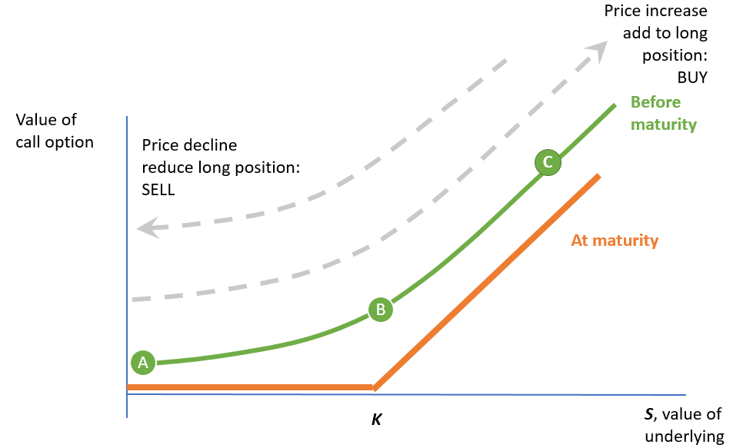
Dynamic Replication and Market Stability
Dynamic rebalancing requires buying and selling
A European call option is equivalent to
Buy underlying when prices are rising
Sell underlying when prices are falling
European Call === MOMENTUM trading:
Reinforce bubbles
Worsens price corrections

